Slide 1
CSC6032 – Advanced Operating Systems
Prof. Yeh-Ching Chung
School of Data Science
Chinese University of Hong Kong, Shenzhen

Slide 2
Class Information
Instructor
Dr. Yeh-Ching Chung (ychung@cuhk.edu.hk)
Course TAs
刘一汉 : 117010177@link.cuhk.edu.cn
杨宇凡 : 117010349@link.cuhk.edu.cn
Lectures
Monday 15:30pm – 16:50pm Zhixin Building 110
Wednesday 15:30pm – 16:50pm Zhixin Building 110
Tutorials
3 sessions (TA will announce the time and classrooms)
Online Platform
Blackboard (https://bb.cuhk.edu.cn)
Website
http://www.cs.nthu.edu.tw/~ychung/syllabus/CSC4180-2023-Spring.htm

Slide 3
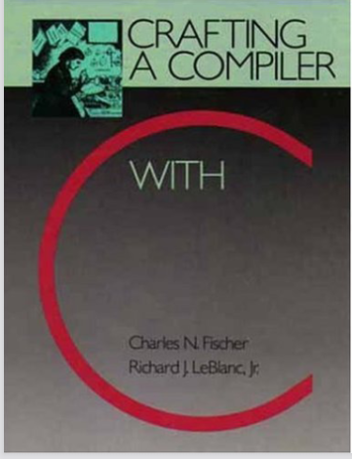
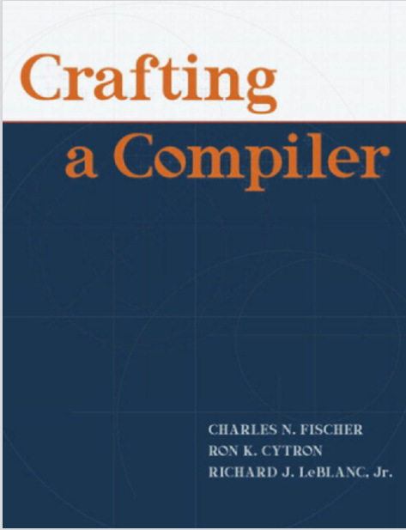
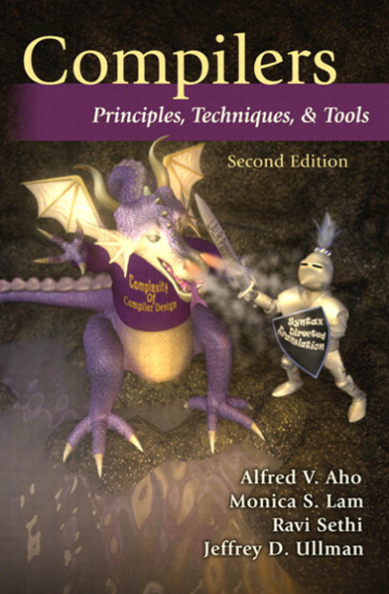
Textbook & Reference
(Textbook)
Crafting a Compiler with C
C. Fisher and R. Leblanc, 1991
(Textbook)
Crafting a Compiler
C. Fisher, Ron K. Cytron, and
R. Leblanc, 2010
(Reference)
Compilers, Principles, Techniques, and Tools,
A. Aho, R. Sethi, J. Ullmman, 2007

Slide 4
Course Syllabus (1)
Advanced operating systems topics
Contents
Introduction
A Simple Compiler
Scanning - Theory and Practice
Grammar and Parsing
Top-Down Parsing
Bottom-Up Parsing
Syntax-Directed Translation
Symbol Table and Declaration Processing
Semantics Analysis
Code Generation

Slide 5
Course Syllabus (2)
Source Program
Tokens
Syntactic
Scanner
Parser
Semantic
Routines
(Character Stream)
Structure
Intermediate
Representation
Symbol and
Attribute
Tables
Optimizer
(Used By All Phases of The Compiler)
Code
Generator
Target Machine Code

Slide 6
Course Assessment
Class participation (5%)
Programming Projects (70%)
Final Exam (25%)
If you need to apply for a leave for final exam, send email to me with supporting document beforehand.
If you are ill, obtain a medical note and email it to me as soon as possible and no later than a week after your absence.
Students are responsible to keep track on their marks.

Slide 7
Learning Outcome
Upon completing this course, students will be able to
Understand the theory of scanner and parser
Understand the contents of code generation
Use Lex and YACC to design a scanner and a parser
Design a simplified C compiler

Slide 8
Academic Honesty
Zero Tolerance
Plagiarism, cheating, misconduct in test/exam will be reported to the School for handing.
Consequences
Zero marks for the concerned assignments/test/exam/whole course, reviewable demerits, non-reviewable demerits, suspension of study, dismissal from University.
University Policy to Academic Honesty
http://www.cuhk.edu.cn/departsite/ar/en/Academic.html

